Slide 1
FLIGHT DELAY ANALYSIS
Team 03
Sonali Chaudhari
Madhumitha Prakash

Slide 2
DEMO
https://github.com/SonaliChaudhari/INFO-7390-ADS-Fall-17-Team03/tree/master/FinalProject
https://flightdelayprediction.appspot.com/
https://github.com/mprakash94/Assignment_2_ADS_INFO7390/blob/master/Project/pp.pptx

Slide 3

WORKFLOW
Web SCRAPING
Data
EXPLOratory data analysis
data wrangling
CLASSIFICATION
Prediction
dEPLOYEMENT

Slide 4
WEB SCRAPING
FLIGHT DATA
Flight delay data was just considered for 2016 and 2017 since the data was 2 to 3 GB and 109 columns. The url used to retrieve the data is, https://transtats.bts.gov/DL_SelectFields.asp. The data has information about arrival and departure data of flights by major carriers and providers. It has information on the origin and destination airports as well as the delays. To retrieve this data, simple web scraping with beautiful soup could not be used. We used selenium for it. The reason was because we had to click on checkbox that said “prezipped” and change the dropdown for year and month before hitting the submit button; this was only possible through the selenium in python.
To utilize selenium below environment setup had to be done:
pip install selenium
Go to http://chromedriver.storage.googleapis.com/index.html?path=2.25/ and install the chrome driver
Make sure to place chrome driver in a location you would remember.
Then do from selenium import webdriver
Need to then specify the path of the chrome driver
path_to_chromedriver = '/Users/madhu/Documents/NEU/Fall 2017/ADS Class/Final project/chromedriver' # change path as needed
browser = webdriver.Chrome(executable_path = path_to_chromedriver)
Once the basic steps were done we can specify the url of the browser similar to what we do in beautiful soup.
WEATHER DATA
In addition to just looking at the flight delay data we took into consideration the weather data as well. This is because wind and precipitation affect the departure time for the flight. The delay time will get affected by it. We got the weather data from https://www.wunderground.com/history/airport/'+station_name+'/2016/1/1/CustomHistory.html?dayend=31&monthend=12&yearend=2016&req_city=&req_state=&req_statename=&reqdb.zip=&reqdb.magic=&reqdb.wmo= .
Here the station name was modified with the 260 or so stations that exist. So using beautiful soap we ran through each station and scraped data for every month for that year and concatenated it to one csv with wind and precipitation data. I have first read in the data into a data frame and proceeded to split the data into the specific months to deal with missing data. We then concatenated the data for the year and create a csv.

Slide 5
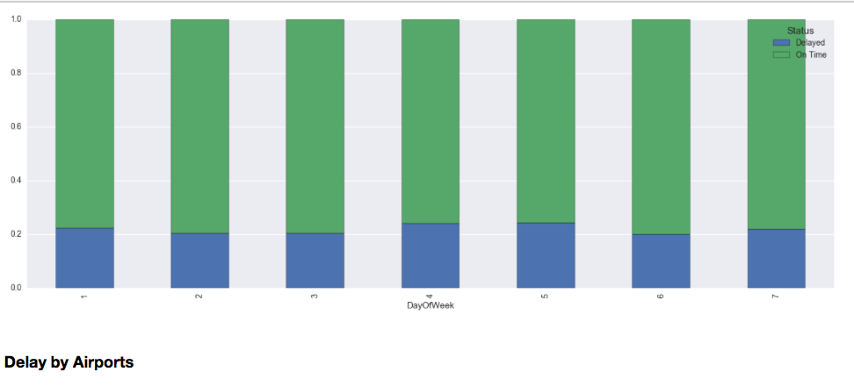
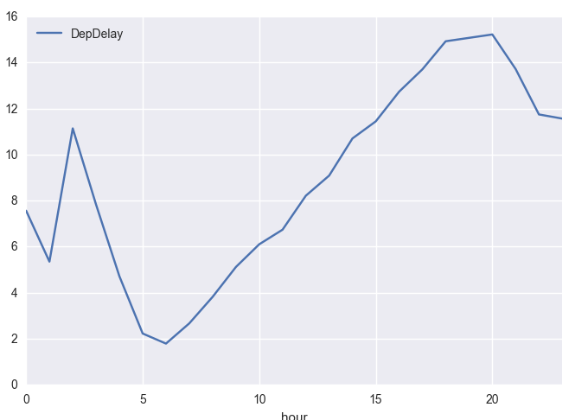
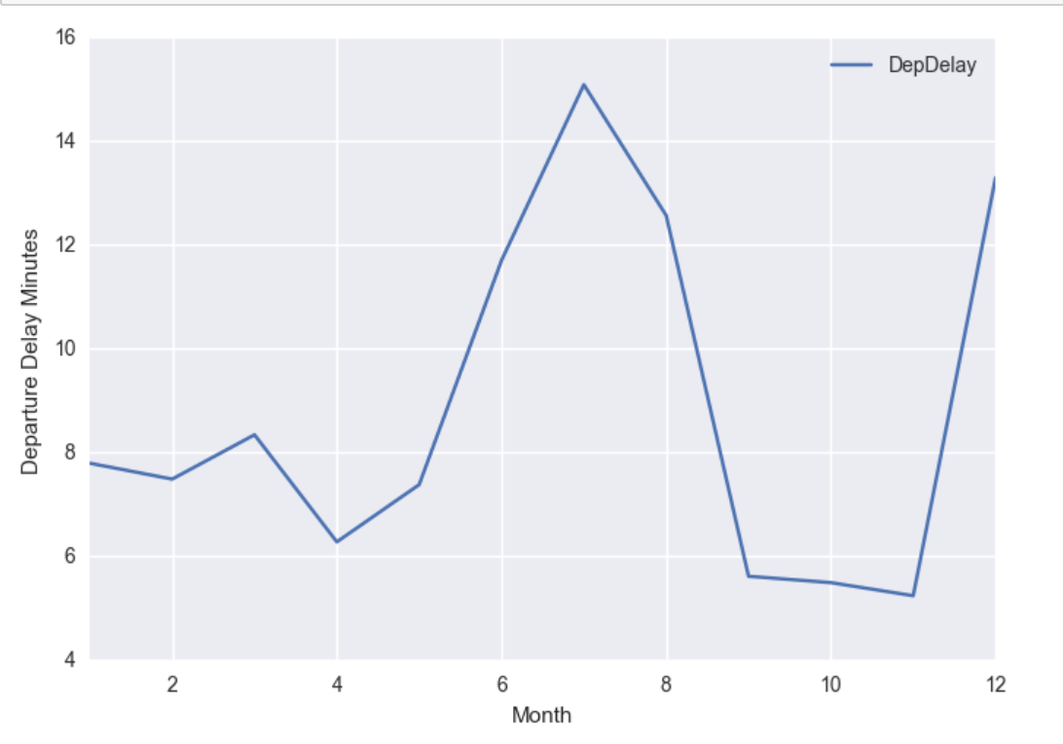
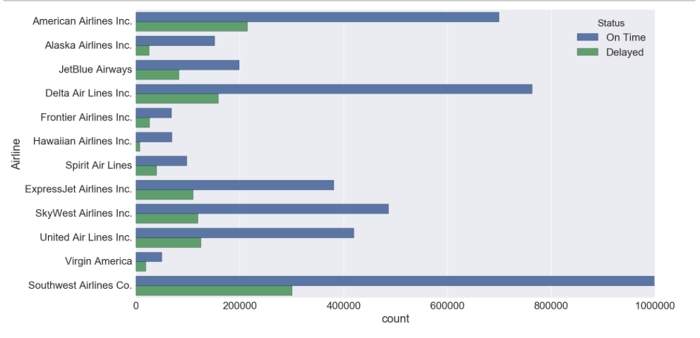
EXPLORATORY DATA ANALYSIS

Slide 6
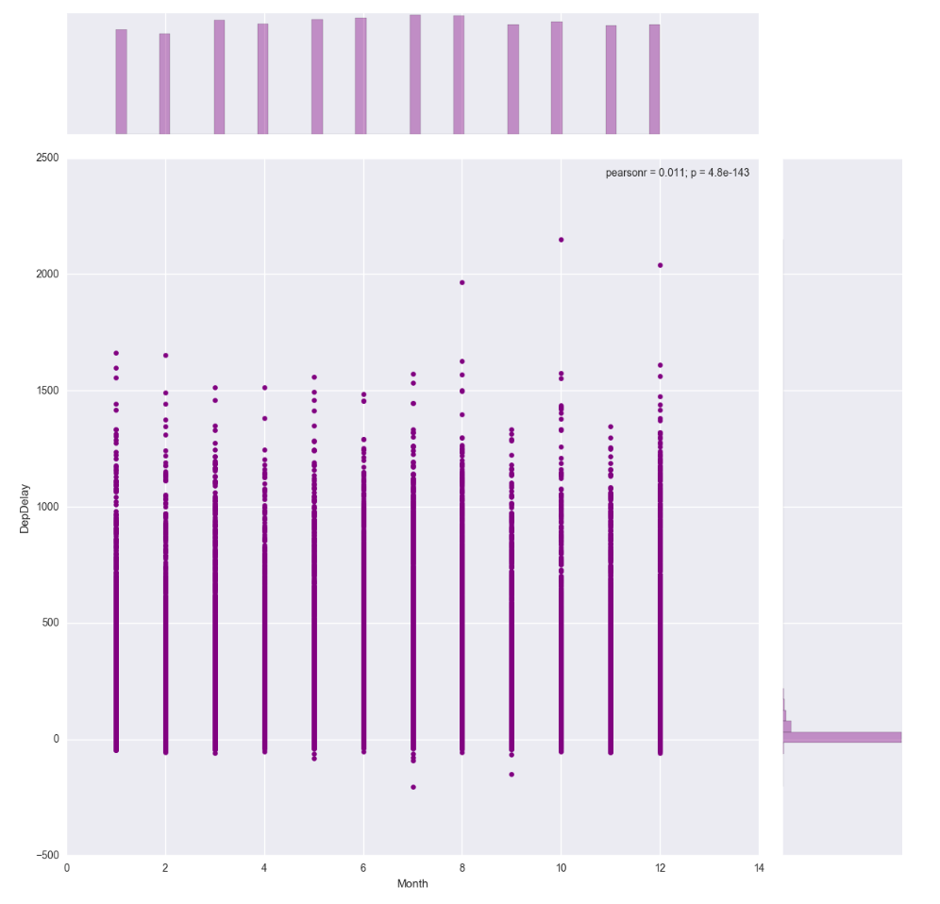
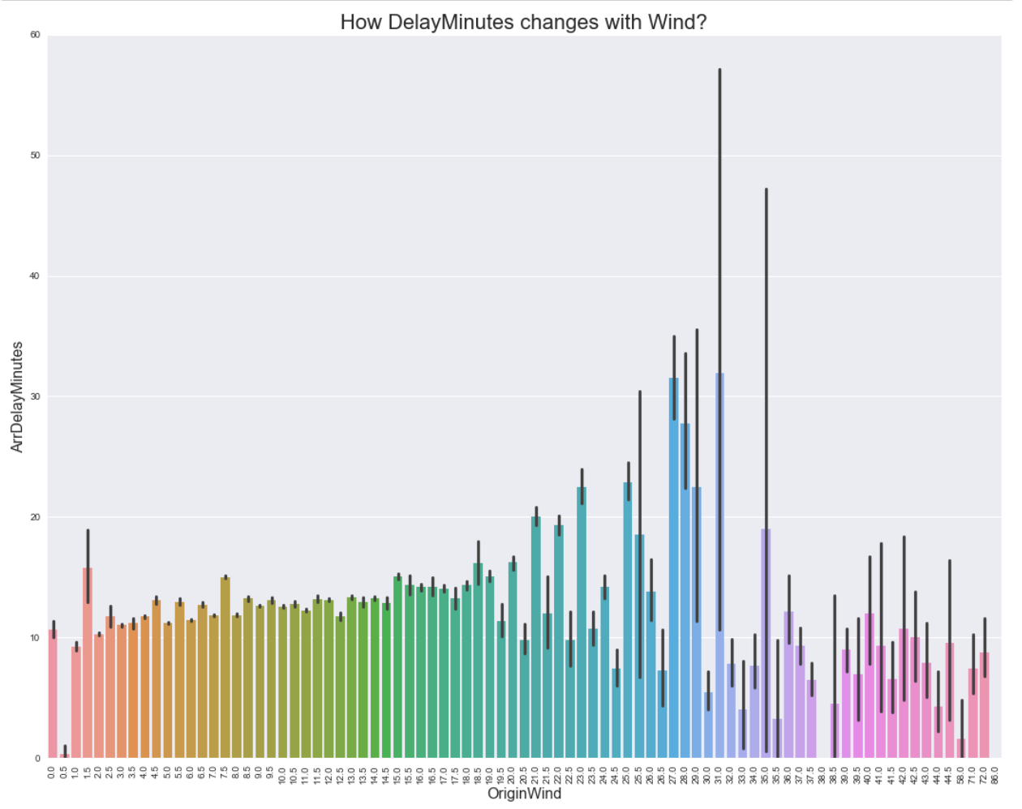
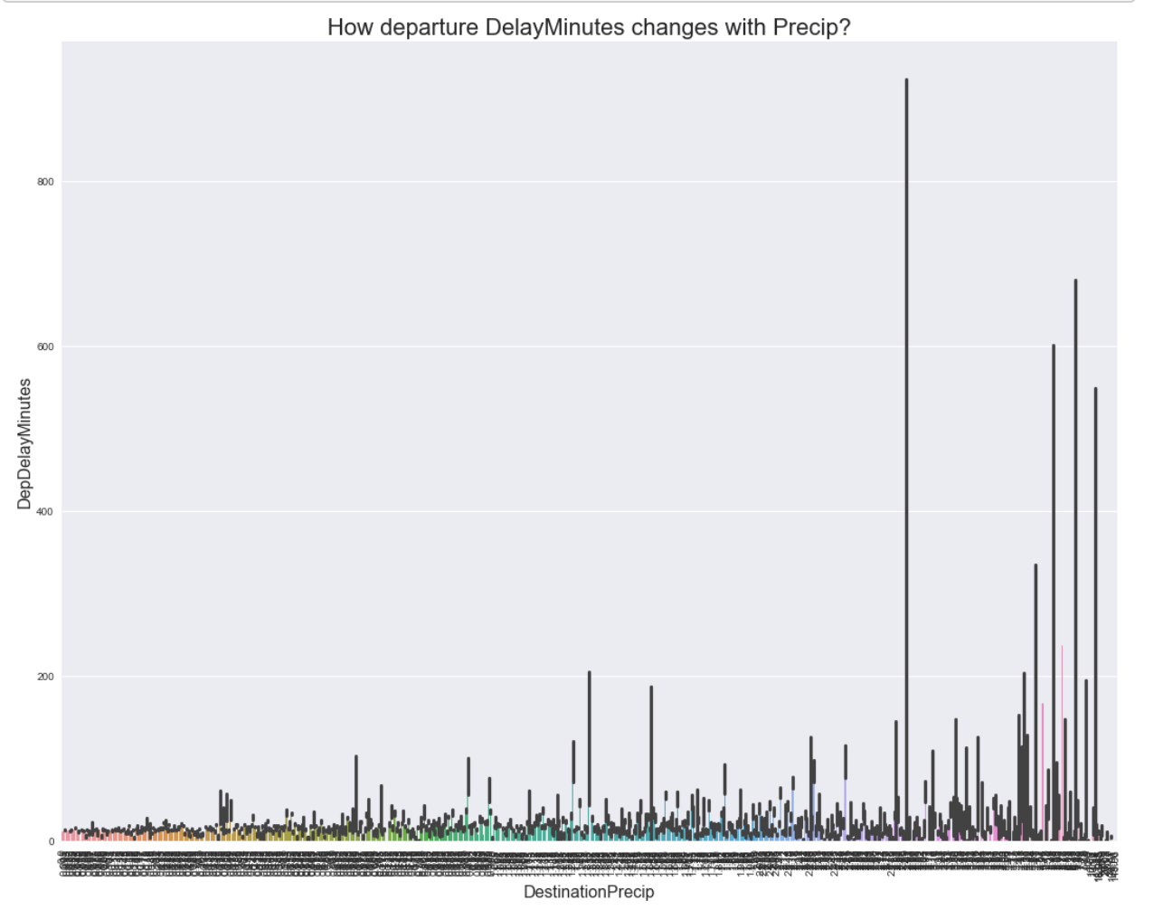
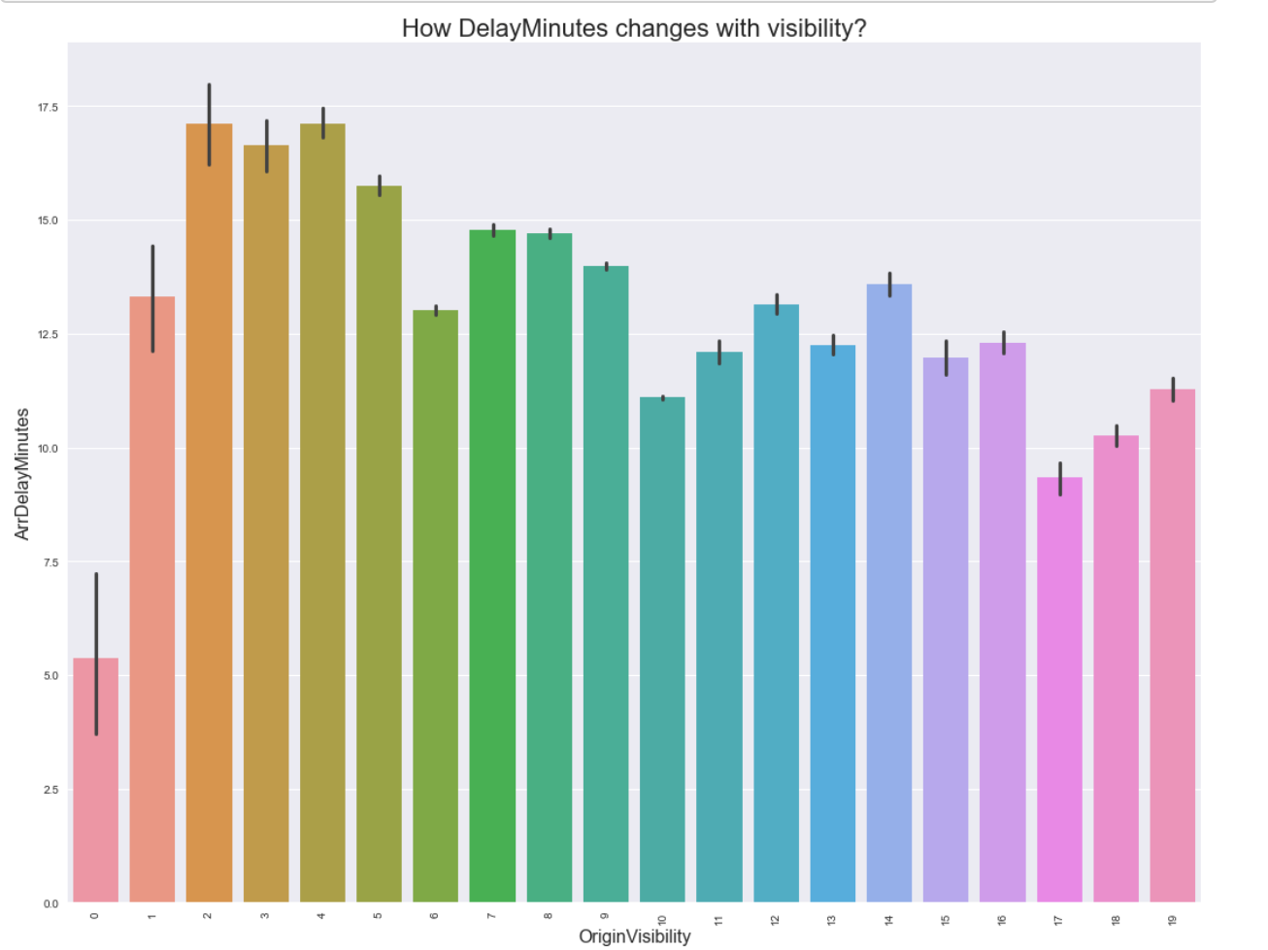
EXPLORATORY DATA ANALYSIS

Slide 7
DATA WRANGLING
FLIGHT DATA
Data before preprocessing (9894115,109)
47 columns having 98% missing values
Columns denoting the same information in different ways.
Outliers
Time conversion to hour block
Got rid of rows having no arrival time information
Flights that were cancelled (65861)
Final Data(8058349, 31)
WEATHER DATA WRANGLING
263 airports
Filling missing
VISIBILITY value
WIND value
PRECIPITATION value

Slide 8
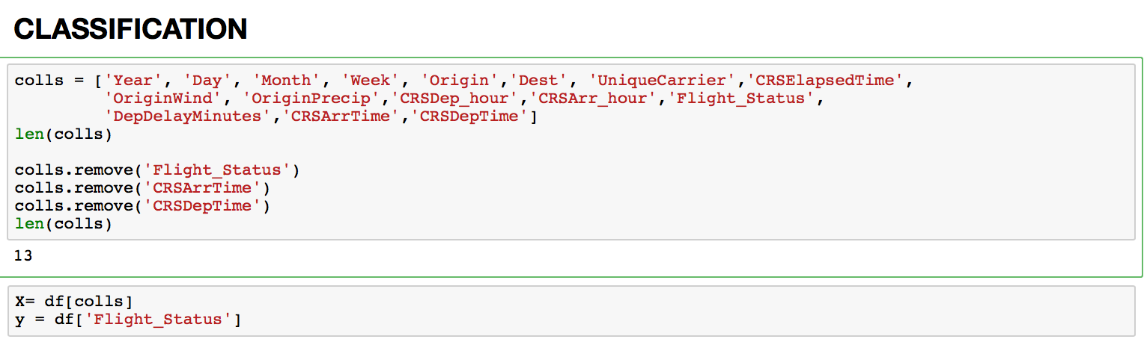
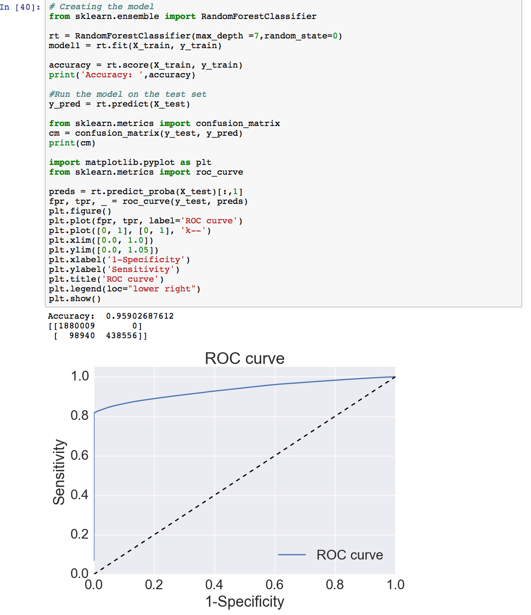
CLASSIFICATION
Random forest worked best for classification
Other models tried Neural Networks

Slide 9
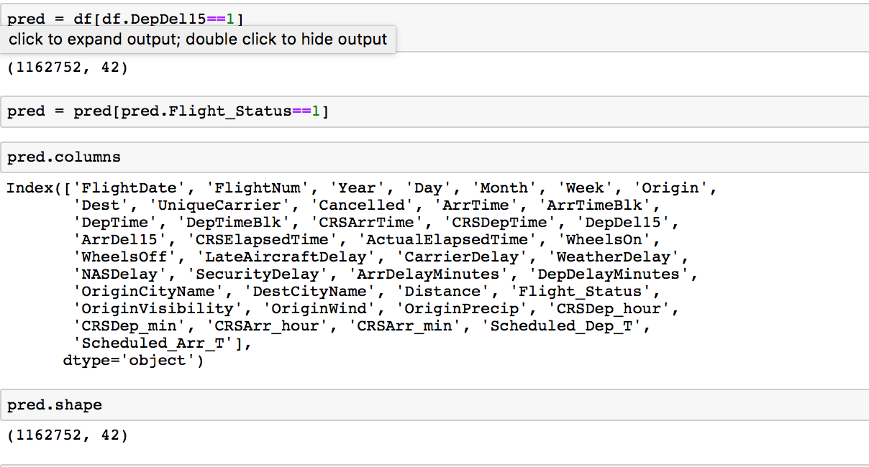
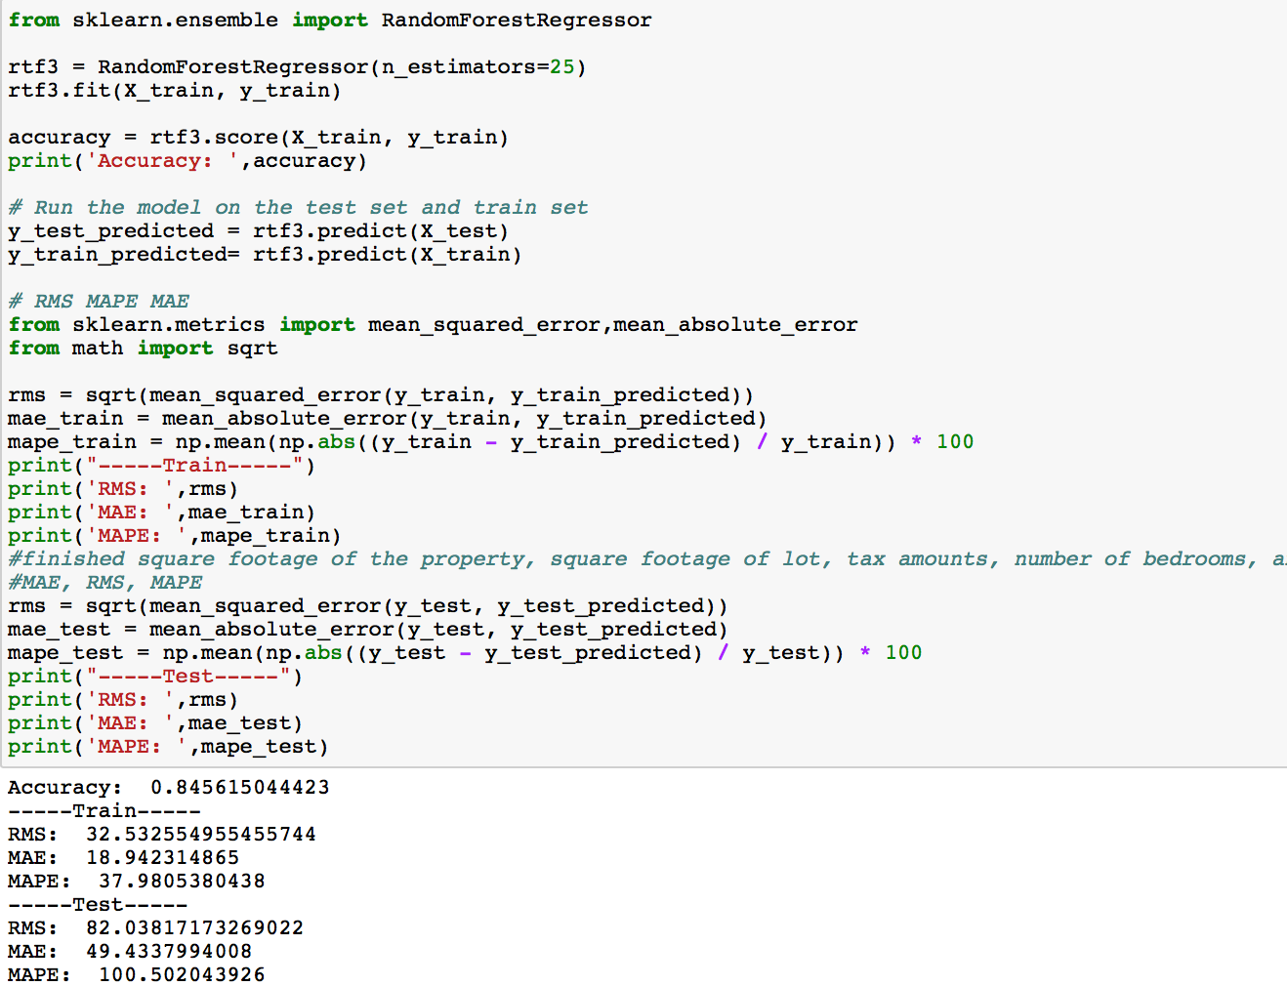
Prediction
Random forest worked best for classification
Other models tried Neural Networks

Slide 10
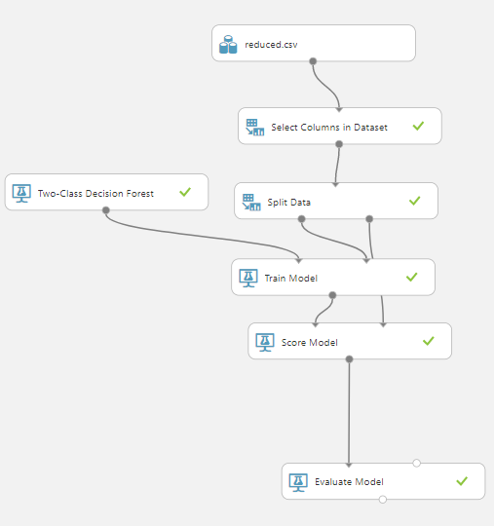
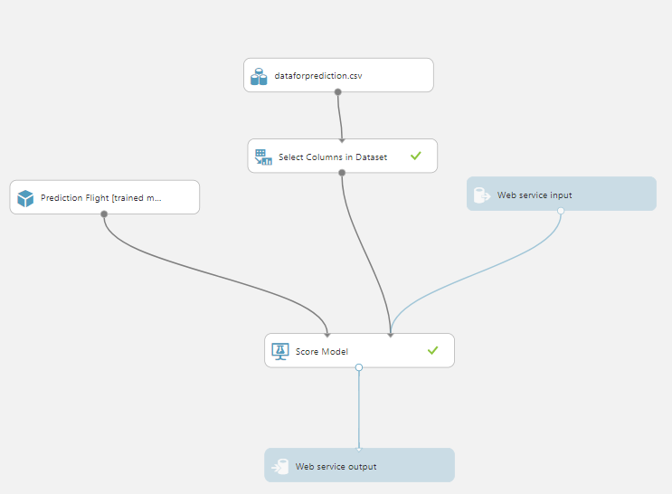
DEPLOYMENT

Slide 11
Thank you!

